Slide 1

ALDEIA DA SERRA REAL ESTATE
scraping | etl | eda | ml | deploy

Slide 2
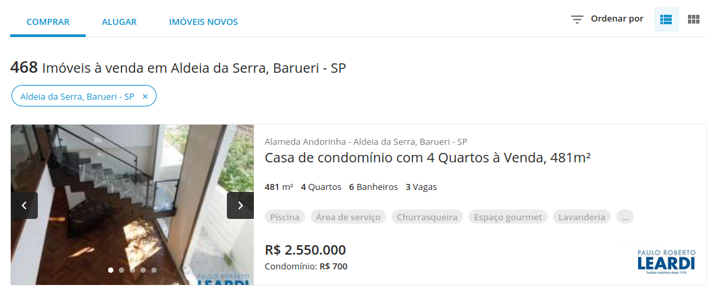
8
1
2
3
4
5
6
7

Slide 3
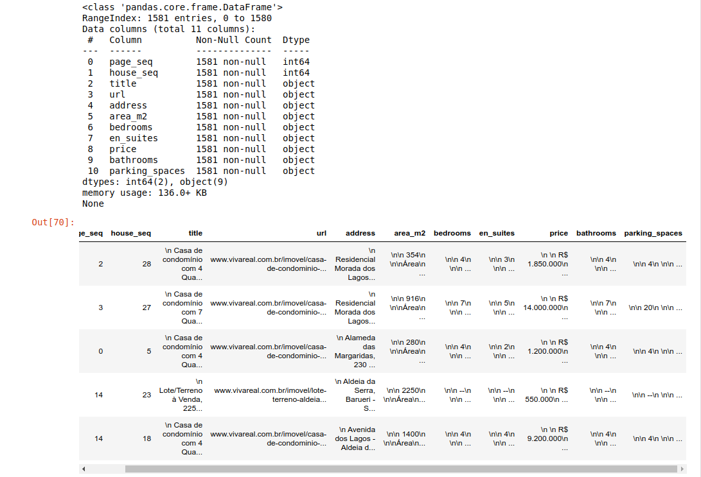

Slide 4
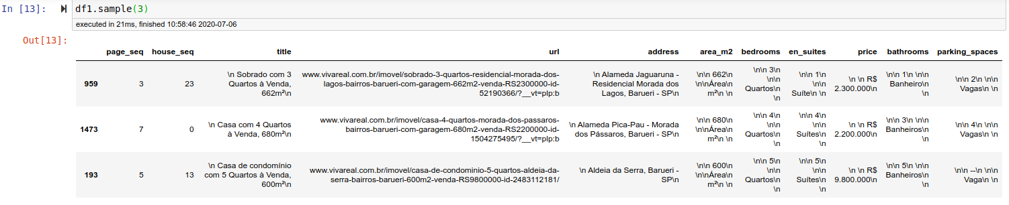
attribute
dust

Slide 5
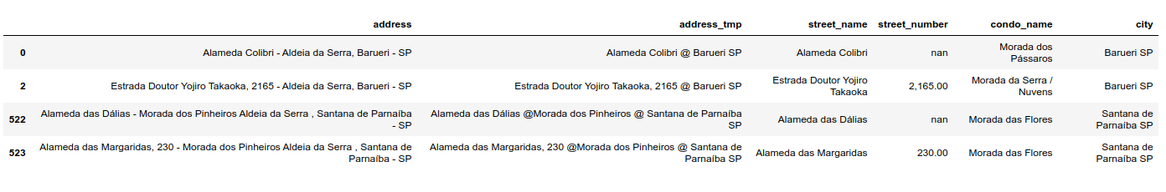
Original
Temporay with separators
“,” and “@”
Result

Slide 6
Linkedin post
This is my very first PYTHON project developed to exercise Python programming, WEB SCRAPING and MACHINE LEARNING skills that I've been developing in the last 18 months together with other tools.
It's comprised of 5 sections mentioned (web scraping, data cleansing, exploratory data analysis, machine learning and deployment). The first two are already available.
The ULTIMATE GOAL is to recommend price for new houses advertisements considering its attributes such as constructed area, condominium where it's located, number of bedrooms, number of bathrooms, number of en suites and number of car spaces.
This is intended to be the first of a series of projects that will also include machine learning models for forecasting, classification, recommendation and so on.
I'll also include at my GitHub address ( github.com/glaubercss ) information of my Business intelligence projects that are already developed, including ETL processes.

